Slide 1

IBM x CAIR watsonx Hackathon
Memorial University
May 29th – 31th 2026

Slide 2
Agenda
01
02
03
04
05
Introductions
Challenge Briefing
Team Formation
06
Logistics
IBM Industry Panel Session
Hackathon Begins!

Slide 3
01
Introductions

Slide 4
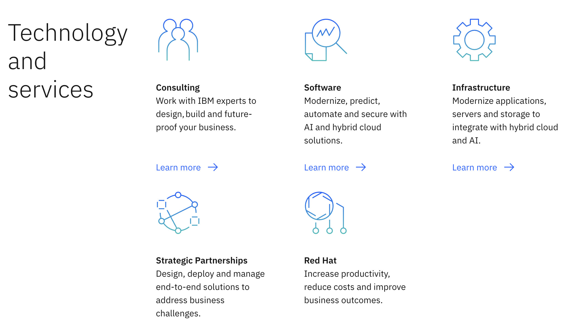
IBM

Slide 5
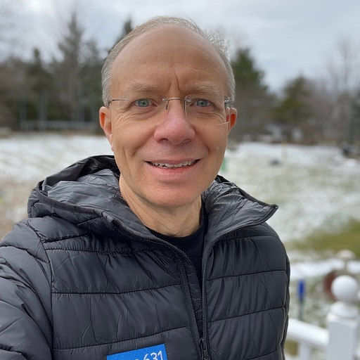

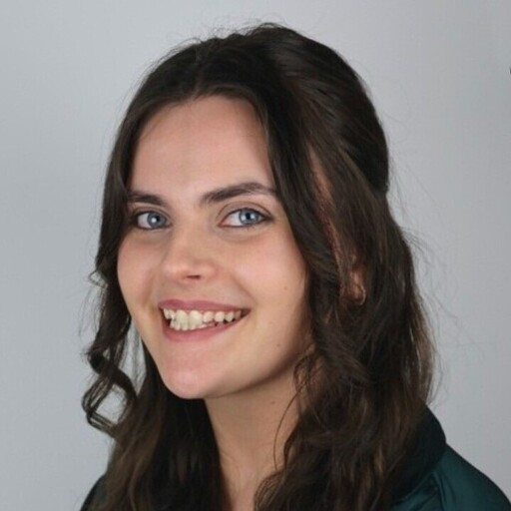
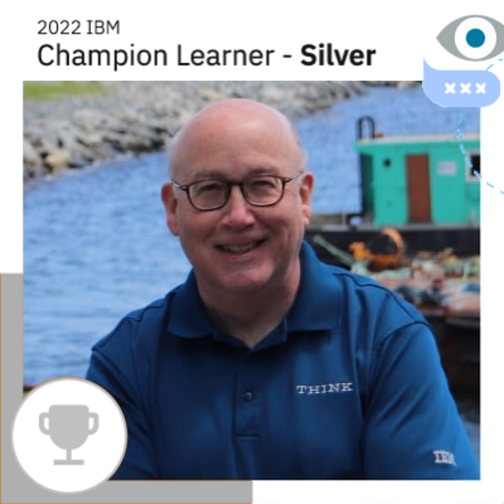
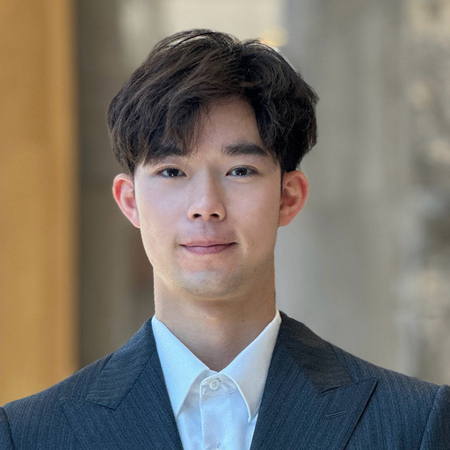
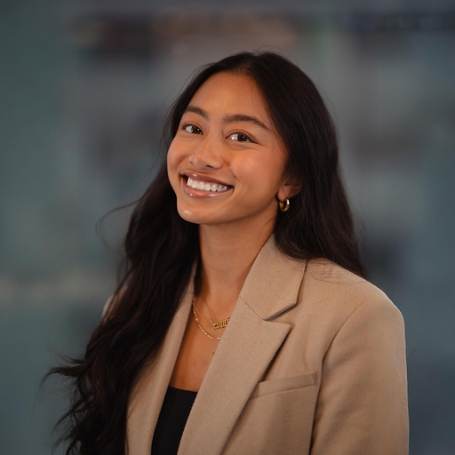
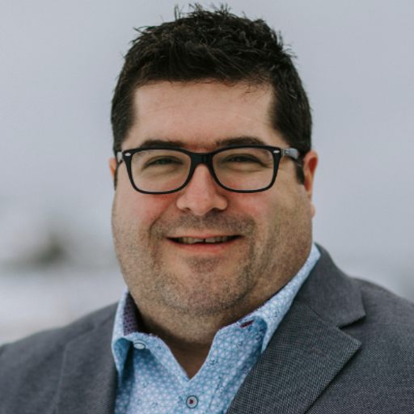
IBM
Randy Giffen
Health Solutions Architect
Debra Henry
Employee Engagement, Culture & Early Talent Leader
Tosha Henry Adams
AI Customer Success Engineer
Rick Power
Innovation Leader
Austin Zhang
AI Customer Success Engineer
Ivy Vu
AI Customer Success Engineer
Kevin Critch
Technology Sales Executive – Atlantic

Slide 6

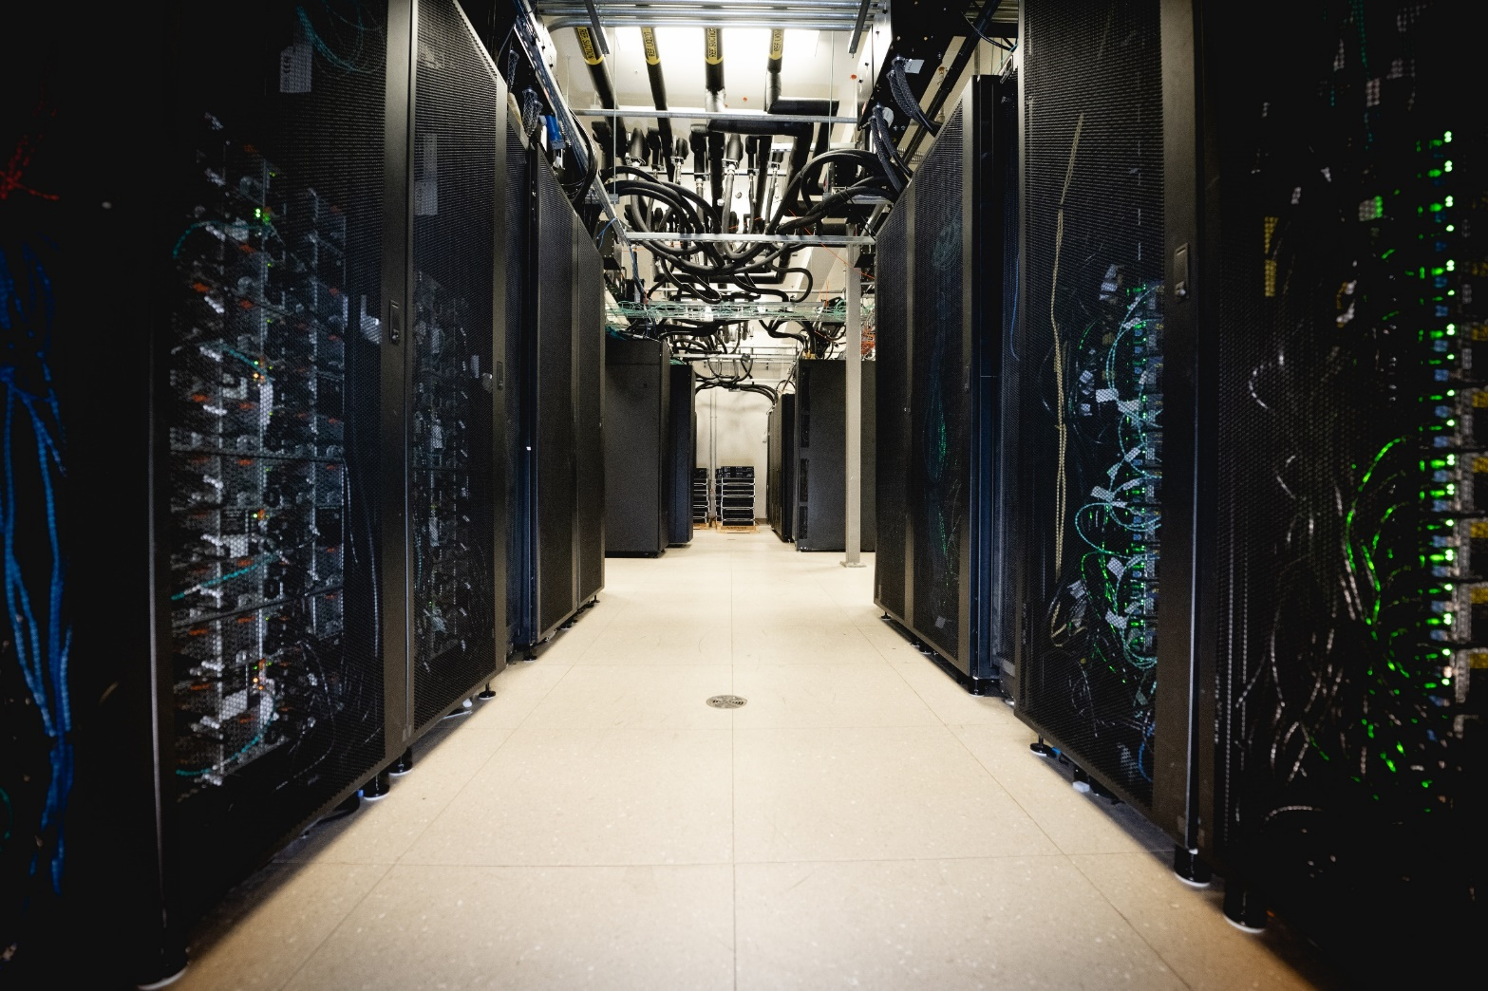

CAIR
Center for Analytics, Informatics, Research
High Performance Compute Data Center on Campus
3 Clusters – Power9+V100, X86+H100, VM with X86+A30
Support research, student groups, capstones
Student Employment building Digital Tools inc. AI
IBM SkillsBuild – 1000+ online training
Pinq2 Quantum Learners access
CAIR Helpdesk

Slide 7

MCE
Memorial Centre for Entrepreneurship
Helps Memorial University students turn ideas into global companies.
Whether you’re building an app, exploring AI, solving industry problems, or testing a side project, MCE connects technical students with the tools, community, and support to launch ideas beyond the classroom.

Slide 8

SDH
Student Design Hub
The Student Design Hub is Memorial University's student design, innovation, and prototyping hub.
We enable students to build critical skills through competitions, innovation challenges, and experiential learning. We provide mentorship, training, funding, space, and equipment to help teams build ambitious projects and showcase them at international competitions.

Slide 9
Hackathon Agenda
Friday May 29th
Sat May 30th
Sun May 31st
5:30pm – Registration & Welcome
6:00pm – Kickoff + Challenge Briefing
6:30pm – Team Formation
6:45pm – Panel Session
7:30pm – Hacking begins!
Full day Hacking!
10am-12pm – In person Mentorship Hours [Optional]
4pm-6pm – Discord Mentorship Hours
10am – 11am: Discord Mentorship Hours
11:00am – Online Final Submissions
11-am- 12:30pm – In person Judging Period
12:30- 2:30pm – Questions for Selected Group
2:30pm – Awards Ceremony
Notes:
3pm – IBM team arrives + set up
Q:
Anthony+ Kirsten : rooms after?
Supporting help? Discord channel? – suggest hours

Slide 10
02
Challenge

Slide 11
Your Challenge
In this hackathon, you will design and build a proof-of-concept agentic AI solution using IBM watsonx products — a series of no-code and low-code products designed to orchestrate AI agents across business workflows. With watsonx, you can create, deploy, and manage intelligent agents and assistants that automate tasks, streamline processes, and enhance productivity.
In groups of 4-5, we invite you to explore creating an AI-powered solution that transforms how organizations work, make decisions, or solve real-world problems in Newfoundland & Labrador. Your project must use at least one IBM watsonx service—and your imagination is the only limit.
You must solve a business challenge in industries such as Ocean, Defense, Energy/Utilities, Mining, Manufacturing. Optional: Other sectors if justified.

Slide 12
Submission Deadline
Video Submissions are due on Sunday May 31st, 2026 11am NST
3-5 minutes long outlining your solution
Judging Panel
Syed Faruk (Memorial PhD Candidate - Computer Science)
Jacqueline French (Associate Director – CAIR)
Randy Giffen (IBM Health Solutions Architect)
Kevin Critch (Technology Sales Leader)
Rick Power (Innovation Leader)
Judges will select their top 3 each for an in person judging panel.

Slide 13
Submission Drive
Submit your video in the Google Drive link
Format:
Team number team name
For example: team1-IBMHackers

Slide 14
Judging Criteria
Video Submissions are due on Sunday May 31st, 2026 11am NST
The top 5-6 groups will need to demonstrate their solution live for the judges and students, while answering questions on their solution.
The judging rubric is as follows:
Problem & Relevance
Innovation
Technical Execution
Video & Communication
Impact & Value
The judging rubric is available on the Google Drive Link

Slide 15
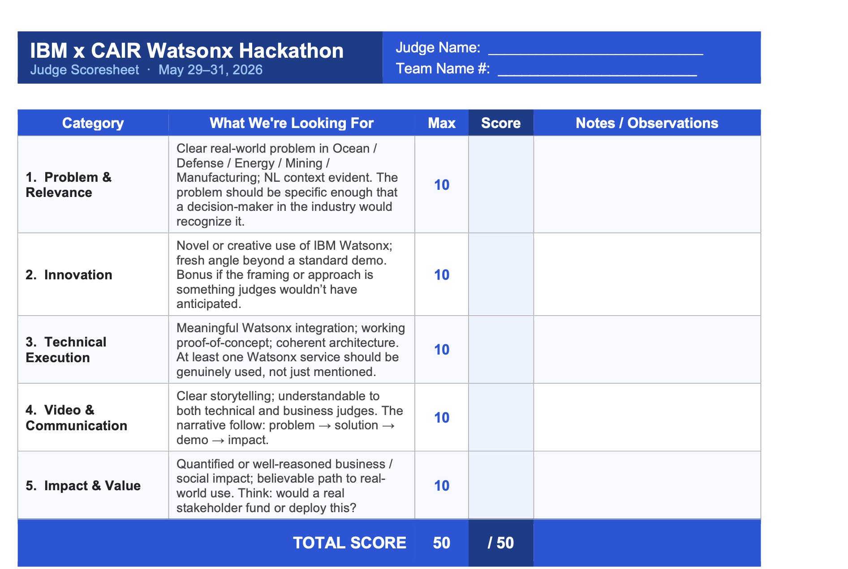
Judging Rubric

Slide 16
Prizes
VIP Experience with IBM
  Lunch with IBM Executives
  Resume Roast (Virtual) + Social Media
  Connect with IBM Managers
2. Swag Bag
3. Swag Bag

Slide 17
03
Team Formation

Slide 18
Team Formation
Groups of 4-5
Each group will get access to 2-3 environments to work on – choose 2-3 emails for access (MUN email)
Email ivy.vu@ibm.com
Team name
Team members – First name, last name and email
Pick 2 emails for environments

Slide 19
04
Logistics

Slide 20

Let’s get Social
Share your hacking photos/posts on social media with us!
Use hashtags:
#watsonx #IBMxMUN #watsonxHackathon
Tag: @IBM @DebraHenry
Top post will receive IBM merch!

Slide 21

Ready. Set. Action
IBM will be filming short clips of you sharing your experience at the Hackathon (Fri/Sat/Sun)
If interested, find Debra Henry at the IBM Booth!

Slide 22
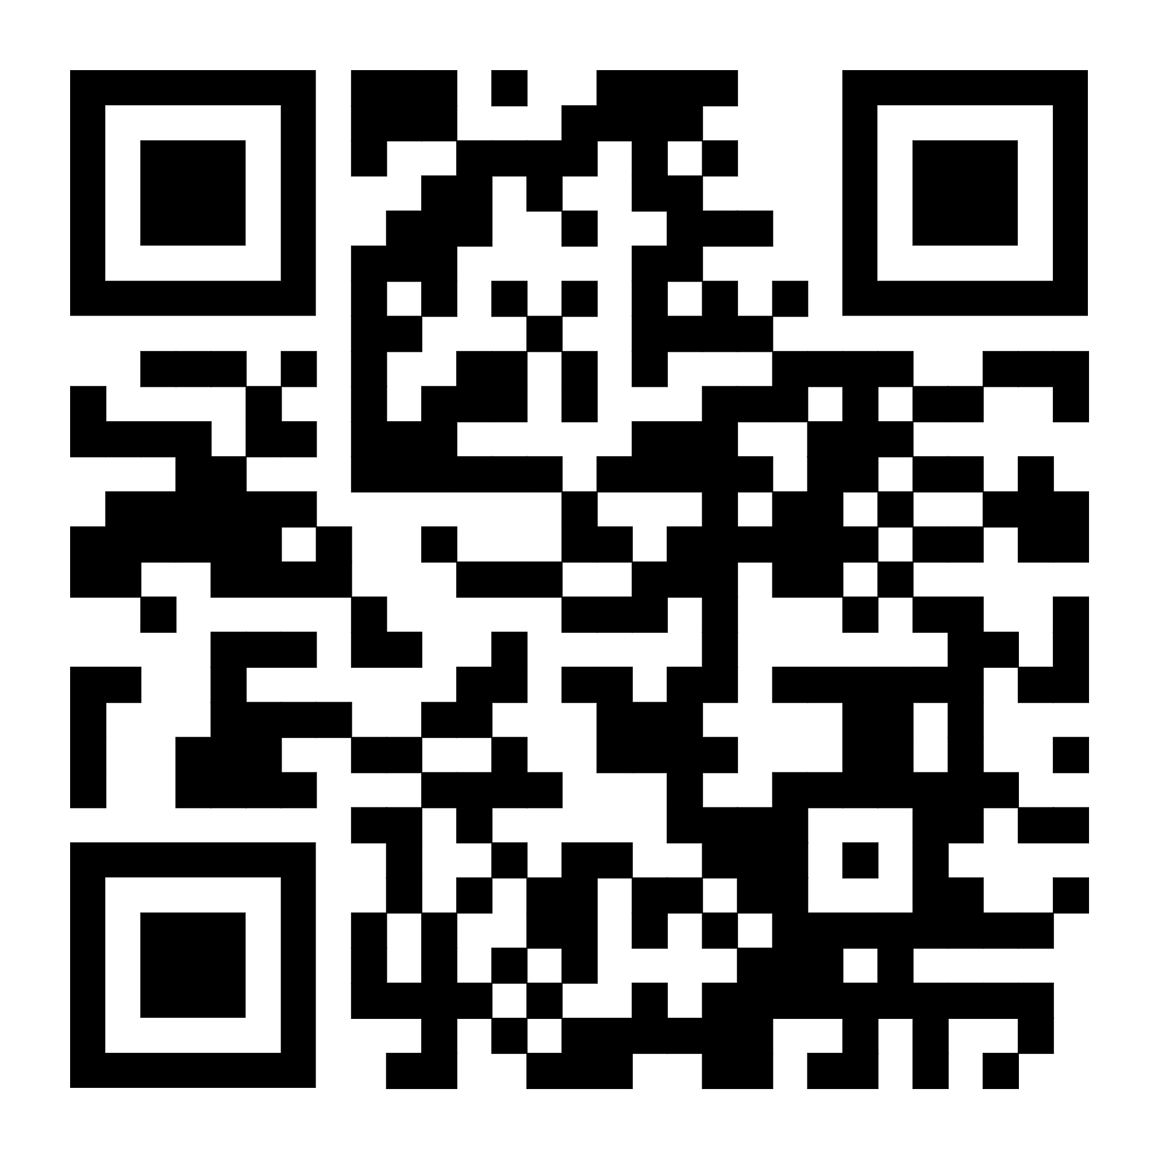
Google Drive
You’ll find:
Kick Off Deck
Challenge Guide
Judging Rubric
Videos/Photos Folder
Challenge Submissions Folder

Slide 23
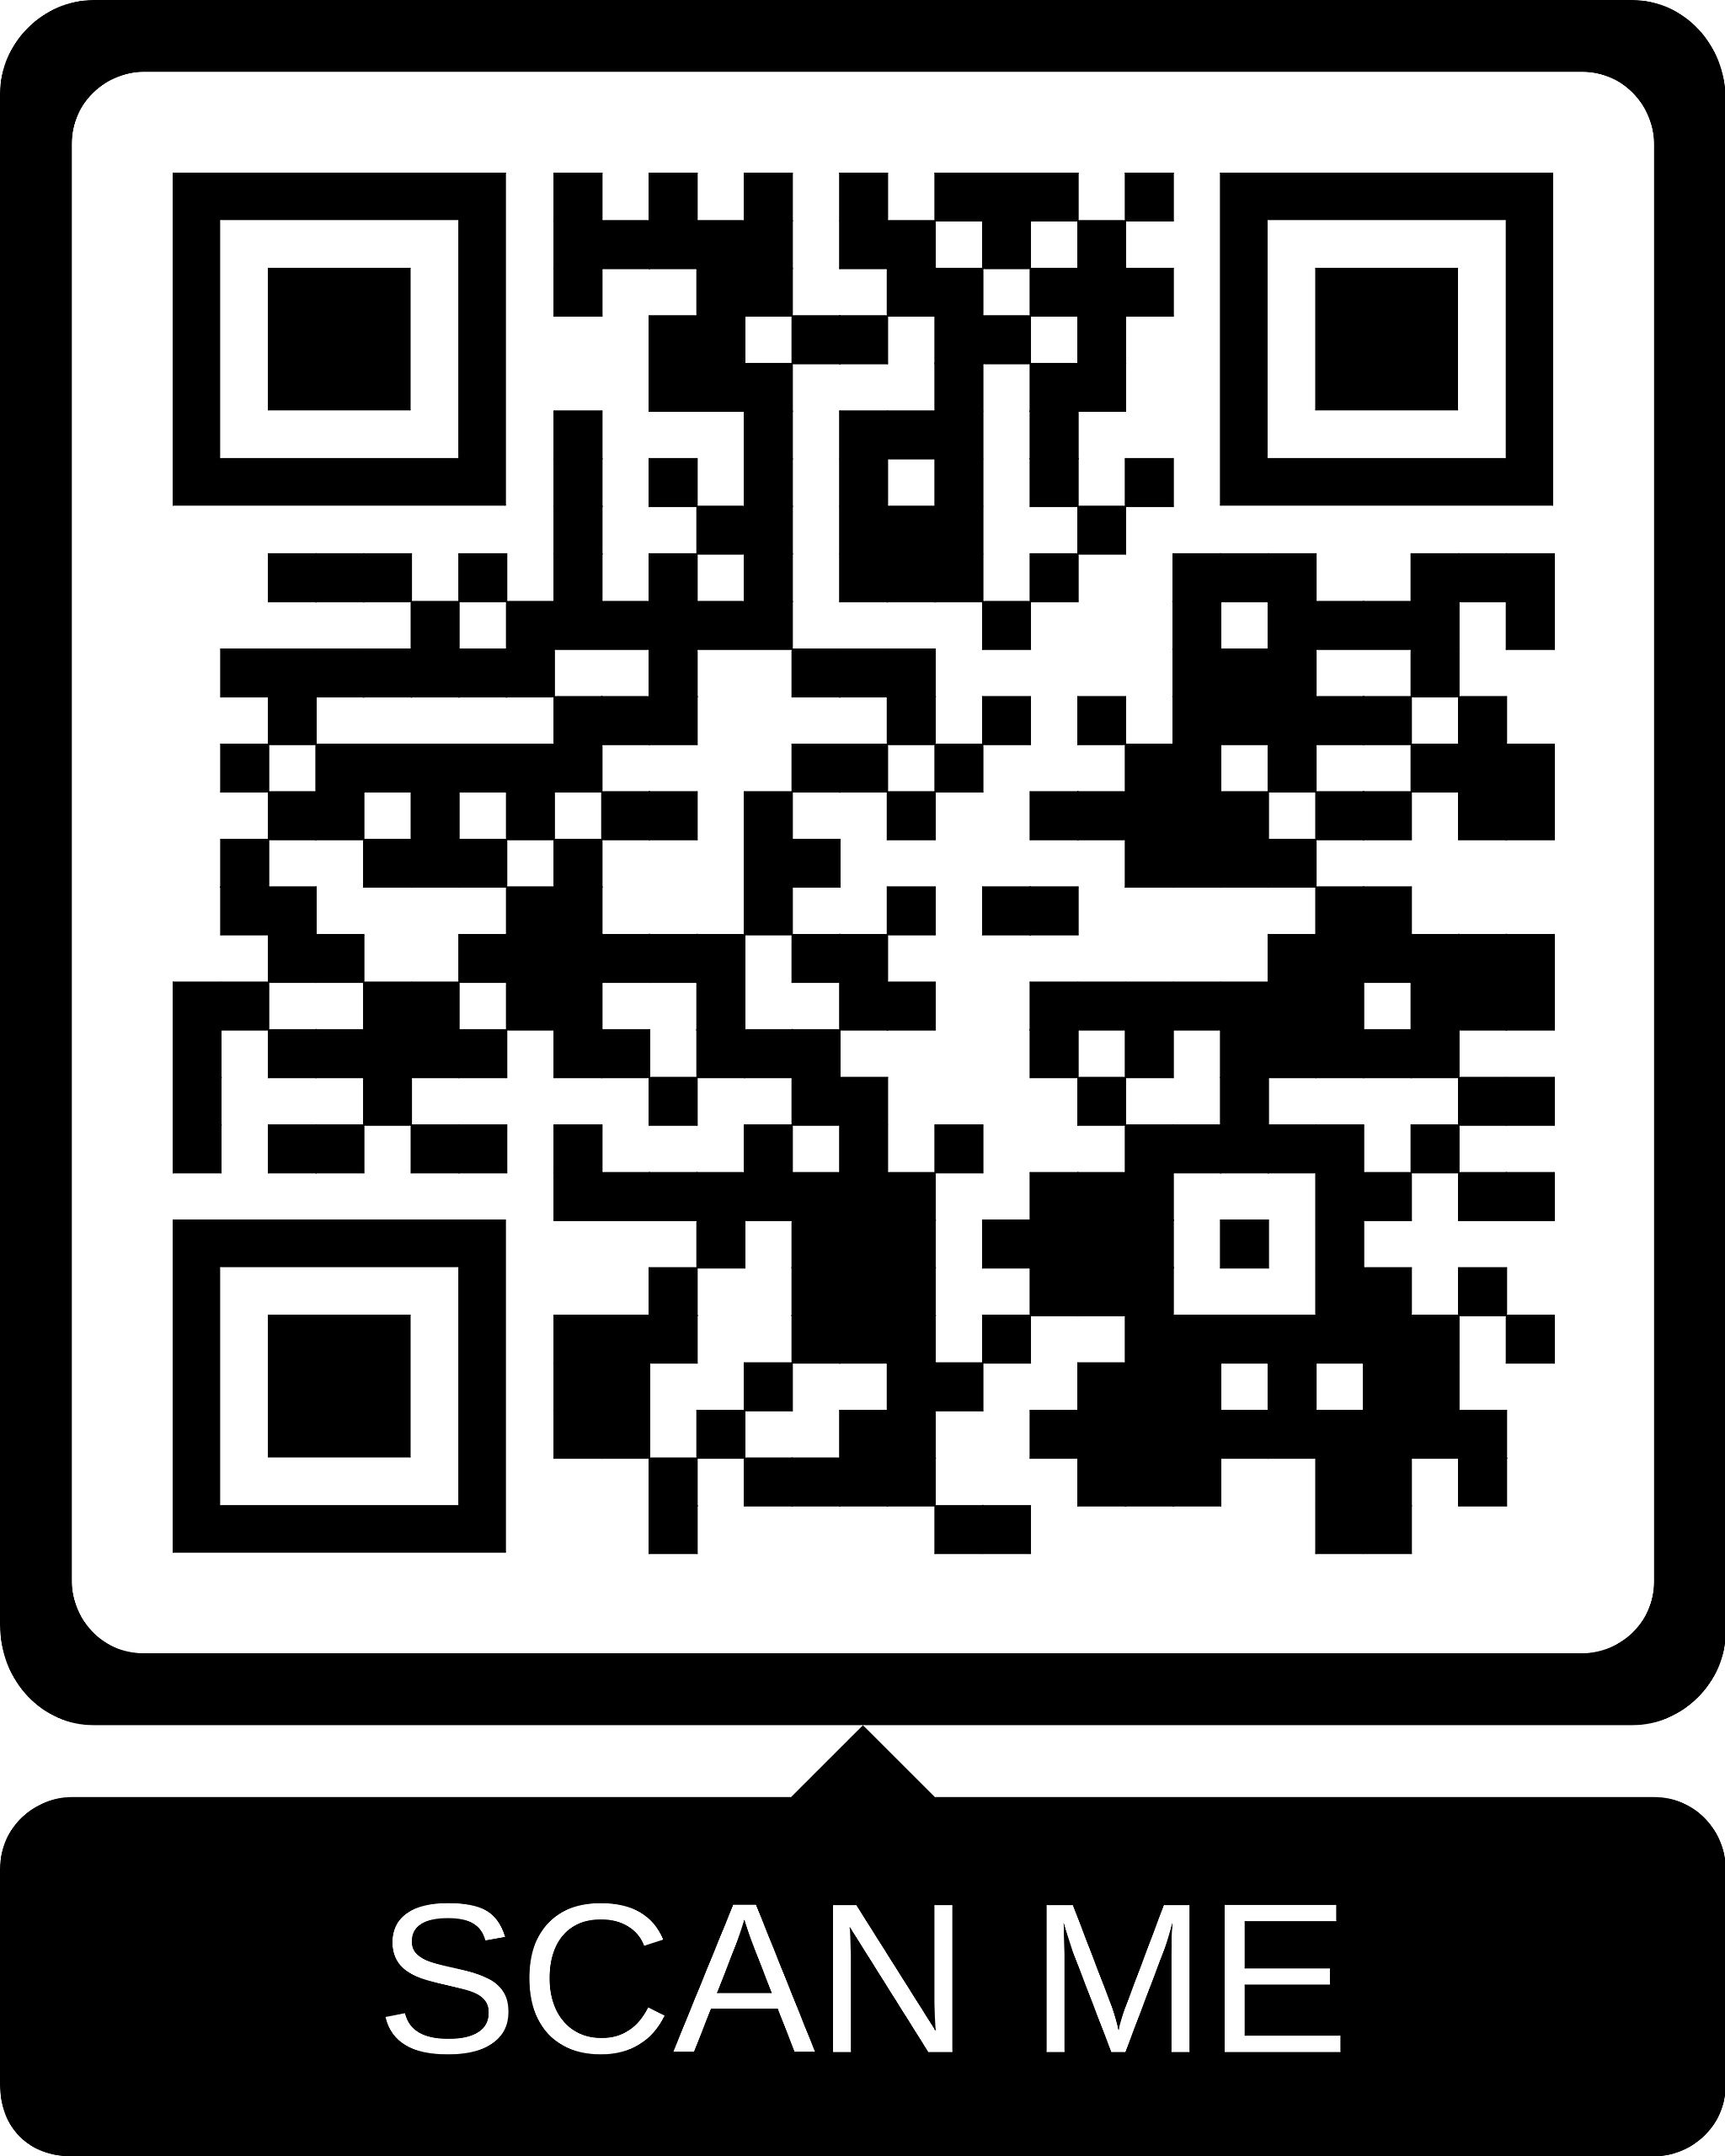
Discord
Saturday May 30th
4pm-6pm – Discord Mentorship Hours
Sunday May 31st
10am-11am – Discord Mentorship Hours

Slide 24
05
Panel Session

Slide 25
IBM Industry Panel
Randy Giffen
Health Solutions Architect
Debra Henry
Employee Engagement, Culture & Early Talent Leader
Tosha Henry Adams
AI Customer Success Engineer

Slide 26
Happy Hacking!

